Slide 1
Azure Data Platform End-to-End Implement a Modern Data Platform Architecture

Slide 2
Begin with the end in mind

Slide 3
Course Objectives
We will understand Cloud and Big Data concepts and technologies used to solve the most common advanced analytics problems
We will understand the role of Microsoft Azure data services in a modern data platform architecture
We will look at individual Azure Data Services and use them to implement a modern data platform reference architecture
We will have a ARM template of a data platform that will enable us to solve most of our data challenges

Slide 4
Important Reminder
The modern data platform architecture proposed in this course aims to help with your technology decisions when architecting data solutions in Azure.
The Azure services covered in this course are only a subset of a much larger family of data services. Some real-world data scenarios may require the use of services not included in this course.
This course does not replace in-depth training on each Azure service covered today.
Some concepts presented in this course can be quite complex and you may need to seek for more information from different sources.

Slide 5
Modern Data Platform Reference Architecture

Slide 6
Lab Guide

Slide 7
The modern data world out there

Slide 8
I tried to understand it, but…
No-SQL
Databricks
Storm
Data Catalog
IoT
PaaS vs IaaS
Hadoop
Power BI
Streaming
Deep Learning
Machine Learning
SMP vs MPP
Predictive
Data Mart
ETL vs ELT
Prescriptive
Data Visualisation
Data Warehouse
Data Lake
Master Data
Big Data
Data Factory
Cloud vs On-prem
Data Quality
Velocity, Variety and Volume
Spark
AI
Semantic Layer

Slide 9
The modern data estate
LOB
CRM
Graph
Image
Social
IoT
Hybrid
Operational databases
Operational databases
Data warehouses
Data warehouses
Data lakes
Data lakes
Reason over any data, anywhere
Flexibility of choice
Security and performance

Slide 10
The Microsoft offering
LOB
CRM
Graph
Image
Social
IoT
Hybrid
Easiest lift and shift with no code changes
SQL Server
Azure Data Services
Industry leader 4 years in a row
Operational databases
Operational databases
70% faster
#1 TPC-H performance
Data warehouses
Data warehouses
2x the global reach
T-SQL query over any data
Data lakes
Data lakes
99.9% SLA
AI built-in | Most secure | Lowest TCO
Reason over any data, anywhere
Flexibility of choice
Security and performance
Notes:
Your data estate is your springboard for innovation.
these new products and services make up the Microsoft data platform
Our cloud-first approach means we work continuously to bring you:
reason over any data
Flexibility of choice
security and performance
Microsoft provides the best location for nurturing innovation today and into the future.
We’re investing in your success. So go ahead and work your magic.

Slide 11




The Azure data landscape
SQL
Azure Data Factory
Azure Import/Export service
Azure SQL DB
Azure Cosmos DB
Azure Synapse Analytics
Azure Analysis Services
Power BI
>_
Azure CLI
Azure SDK
10 01
Azure Blob Storage
Azure Data Lake Store
Azure HDInsight
Azure
Databricks
Azure ML
ML Server
Azure
Databricks
Azure IoT Hub
Azure event hubs
Azure Search
Azure Data Catalog
Azure Stream
Analytics
Azure HDInsight
Azure
Databricks
Bot service
Cognitive services
Kafka on Azure HDInsight
NSG
Azure ExpressRoute
Azure Active Directory
Azure network
security groups
Azure key
management service
Operations
Management Suite
Azure Functions
Visual Studio
Notes:
Explain that there is a number of data services available, each with their distinctive capabilities and use cases. No need to provide detailed explanation of each services as most of them will be covered in the following slides.

Slide 12
The Azure Big Data landscape
SQL
Azure Data Factory
Azure Import/Export service
Azure SQL DB
Azure Cosmos DB
Azure Synapse Analytics
Azure Analysis Services
Power BI
>_
Azure CLI
Azure SDK
10 01
Azure Blob Storage
Azure Data Lake Store
Azure HDInsight
Azure
Databricks
Azure ML
ML Server
Azure
Databricks
Azure IoT Hub
Azure event hubs
Azure Search
Azure Data Catalog
Azure Stream
Analytics
Azure HDInsight
Azure
Databricks
Bot service
Cognitive services
Kafka on Azure HDInsight
NSG
Azure ExpressRoute
Azure Active Directory
Azure network
security groups
Azure key
management service
Operations
Management Suite
Azure Functions
Visual Studio

Slide 13


Our job, pretty much

Slide 14
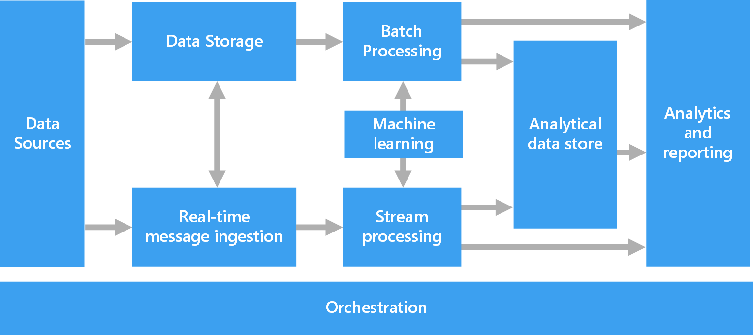
Azure Data Architecture Guide
Valuable collection of architecture principles to help you with your technology choices
https://aka.ms/adag

Slide 15
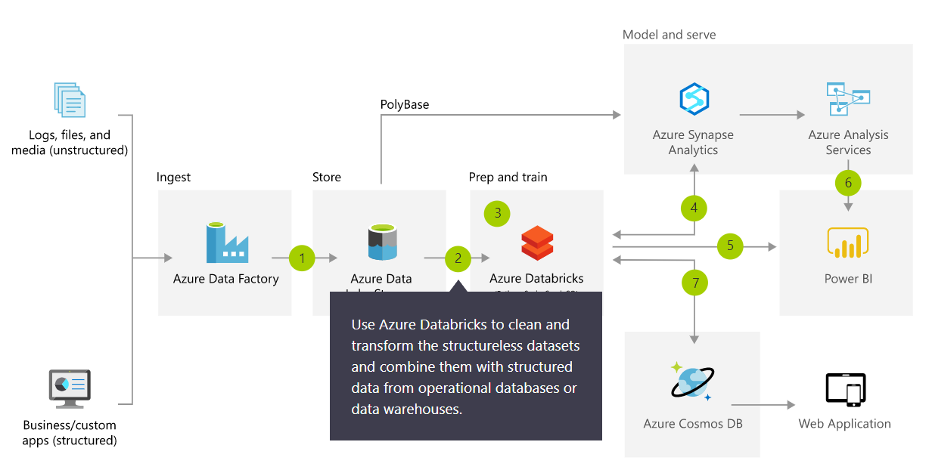
Azure Architecture Solutions
Collection of reference architectures for most common challenges
https://azure.microsoft.com/en-us/solutions/architecture/

Slide 16
Modern Data Platform Solution Scenarios
Big Data and advanced analytics
SQL
Modern data warehousing
Advanced analytics
Real-time analytics
“We want to integrate all our data—including Big Data—with our data warehouse”
“We’re trying to predict when our customers churn”
“We’re trying to get insights from our devices in real-time”

Slide 17
Modern Data Platform Concepts Part I

Slide 18
IaaS vs PaaS vs SaaS
On Premises
Physical / Virtual
Infrastructure
as a Service (IaaS)
Platform
as a Service (PaaS)
Software
as a Service (SaaS)
You manage
Applications
Applications
Applications
Applications
You scale, make resilient and manage
You scale, make
resilient & manage
Data
Data
Data
Data
Runtime
Runtime
Runtime
Runtime
Scale, Resilience and management by Microsoft
Middleware
Middleware
Middleware
Scale, Resilience and management by Microsoft
Middleware
O/S
O/S
O/S
O/S
Virtualization
Virtualization
Managed by Microsoft
Virtualization
Virtualization
Servers
Servers
Servers
Servers
Storage
Storage
Storage
Storage
Networking
Networking
Networking
Networking
Azure
Virtual Machines
Azure
Cloud Services

Slide 19
What is a Data Warehouse?
A data warehouse is a large collection of business data used to help an organization make decisions. Data in the Data Warehouse has been identified as valuable to specifically defined business cases and is stored in a structured way readily available for reporting and data analysis.
It is not an Operational Database
Different workload types: transactional (DB) versus analytics (DW)
It is not a Data Lake
These are different concepts, they can co-exist and they compliment each other
It is not a Data Mart
A data mart is a subject-oriented database populated from a subset of the Data Warehouse
Notes:
Characteristics

Slide 20
Modern Data Warehousing

Slide 21
Modern data warehousing
The modern data warehouse extends the scope of the data warehouse to serve Big Data that’s prepared with techniques beyond relational ETL
SQL
Modern data warehousing
Advanced analytics
Real-time analytics
“We want to integrate all our data—including Big Data—with our data warehouse”
“We’re trying to predict when our customers churn”
“We’re trying to get insights from our devices in real-time”

Slide 22
Modern data warehousing pattern
LOB
CRM
INGEST
STORE
PREP
MODEL & SERVE (& store)
BI + Reporting
Graph
Advanced Analytics
Image
Social
Data orchestration and monitoring
Big data store
Transform & Clean
Data warehouse
AI
IoT
Cloud
Notes:
Slide objectives:
- Explain that the pattern (ingest, store, prepare and model&serve) is consistent. It is going to be applied using different technologies depending on the data scenario.

Slide 23
SQL Server and Azure SQL Database

Slide 24
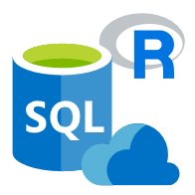
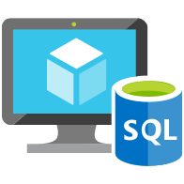

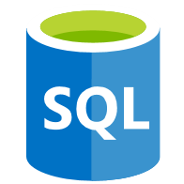
Data platform continuum
PaaS & SaaS
Azure SQL Database
Virtualized Database
Shared lower cost
IaaS
SQL Server in Azure VM
Virtualized Machines
Virtual
SQL Server Private Cloud
Virtualized Machine + Appliance
Physical
SQL Server
Physical Machine (raw iron)
Dedicated higher cost
Higher administration
Lower administration
Notes:
Objective: One of the first things to understand in any discussion of Azure versus on-premises SQL Server databases is that you can use it all. The Microsoft data platform leverages SQL Server technology and makes it available across physical on-premises machines, private cloud environments, third-party hosted private cloud environments, and public cloud. This enables you to meet unique and diverse business needs through a combination of on-premises and cloud-hosted deployments, while using the same set of server products, development tools, and expertise across these environments.
Talking Points:
As seen in the diagram, each offering can be characterized by the level of administration you have over the infrastructure (on the X axis), and by the degree of cost efficiency achieved by database level consolidation and automation (on the Y axis).
When designing an application, four basic options are available for hosting the SQL Server part of the application:
SQL Server on nonvirtualized physical machines
SQL Server in on-premises virtualized machines (private cloud)
SQL Server in Azure Virtual Machine (public cloud)
Azure SQL Database (public cloud)

Slide 25
SQL Server 2019 big data, analytics, and AI
Data virtualization
Managed SQL Server, Spark, and data lake
Complete AI platform
Admin portal and management services
Integrated AD-based security
Analytics
T-SQL
Apps
REST API containers for models
SQL Server External Tables
SQL Server
Spark
SQL Server
ML Services
Spark & Spark ML
Compute pools and data pools
Scalable, shared storage (HDFS)
Open database connectivity
NoSQL
Relational databases
HDFS
External data sources
HDFS
Combine data from many sources without moving or replicating it
Scale out compute and caching to boost performance
Store high volume data in a data lake and access it easily using either SQL or Spark
Management services, admin portal, and integrated security make it all easy to manage
Easily feed integrated data from many sources to your model training
Ingest and prep data and then train, store, and operationalize your models all in one system
Notes:
Amit to cover

Slide 26
Azure SQL Database deployment option
Azure SQL Database
Single
Elastic Pool
Managed Instance
Database-scoped deployment option with predictable workload performance
Shared resource model optimized for greater efficiency of multi-tenant applications
Instance-scoped deployment option with high compatibility with SQL Server and full PaaS benefits
Best for apps that require resource guarantee at database level
Best for SaaS apps with multiple databases that can share resources at database level, achieving better cost efficiency
Best for modernization at scale with low friction and effort
General Purpose
Service Tiers
Business Critical
Hyperscale
Serverless
Notes:
Overview: Azure SQL Database provides you with several deployment options to meet your workload needs. It’s the same SQL engine for all these options.
Talking Points:
There are three hosting options available in Azure SQL Database:
Each standalone database is assigned a certain amount of resources via performance tiers: Basic, Standard, and Premium. The emphasis of this offering focuses on a simplified database-scoped programming model and applications with a predictable pattern and relatively stable workload.
An elastic database pool is a shared resource model that enables higher resource utilization efficiency, and all the databases within an elastic pool share predefined resources within the same pool. The emphasis of this offering is on a simplified database-scoped programming model for multi-tenant SaaS apps. The workload pattern is well-defined and is highly cost-effective in multi-tenant scenarios. For ISVs with SaaS apps, the savings can be significant, in the hundreds of thousands of dollars or more.
A SQL Database Managed Instance offers a simplified instance-scoped programming model that is like an on-premises SQL Server instance. The databases in a SQL Database Managed Instance share the resources allocated to the Managed Instance, and the Managed Instance also represents the management grouping for these databases. The emphasis of this offering is on high compatibility with the programming model of an on-premises SQL Server and out-of-box support for a large majority of SQL Server features and accompanying tools/services.
There are also three service tiers available in Azure SQL Database
[click to next slide]

Slide 27
Azure SQL Managed Instance
Enable full isolation from other tenants without resource sharing
Promote secure communication over private IP addresses with native VNET integration
Enable your on-premise identities on cloud instances, through integration with Azure Active Directory and AD Connect
Combine the best of SQL Server with the benefits of a fully-managed service
Use familiar SQL Server features in SQL Database Managed Instance
VNET support in SQL Database Managed Instance
VNet-to-VNet
Web app (public IP)
VNet2
SQL instance #1
SQL instance #2
Network isolation (customer VNET)
Tenant isolation (compute, storage)
SQL instance #3
VNet1
“Virtual data cluster” dedicated to customer (virtual private cluster, VNET, private IPs)
VPN/Express route gateway
On-premises
Notes:
SQL Database Managed Instance provides complete workload isolation of your workloads through native VNET support. We use virtual data clusters to describe the degree of isolation that customer workloads will experience with SQL Database Managed Instance. During service provisioning (on Azure Portal or through REST API), you can choose the virtual network (VNET) and the subnet to achieve full networking isolation for your Managed Instances. Once created, instances in the VNET can be reached using Azure networking mechanisms (VPN and Express Route gateways).
To two levels of isolation are provided:
Cluster (tenant ring) level: Managed Instances for a tenant are fully isolated from other tenants. No connectivity or resource sharing is possible between different tenants.
Networking level: joining instances to a subnet in a VNET and restricting access to private IP addresses only provides full isolation from public Internet.

Slide 28
Azure Data Factory

Slide 29




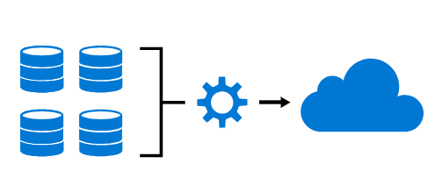
Azure Data Factory
Hybrid data integration service for enabling code-free ETL
Industry leading data ingestion
Visual
No Code
Hybrid
Pay only for what you use
Managed SSIS
Productive & trusted hybrid data integration service that simplifies ETL with any data, from any source, at scale.

Slide 30
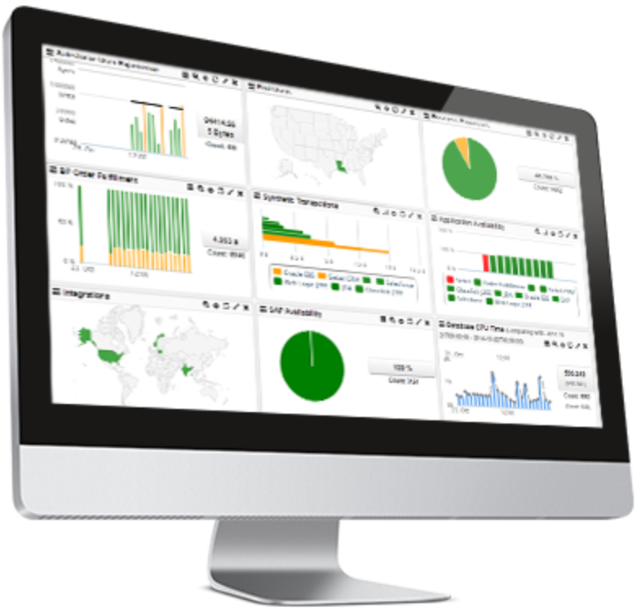












Command and Control
Data
Data Factory
A data integration account.
Location of orchestration, service metadata
UX & SDK
Authoring | Monitoring/Mgmt
Azure Data Factory v2 Service
Scheduling | Orchestration | Monitoring
Integration Runtime (IR)
ADF’s execution engine
Azure Integration Runtime
Self-Hosted Integration Runtime
SSIS Integration Runtime
Three core capabilities:
data movement
pipeline activity execution
SSIS package execution
Pipeline
SSIS Package
Self Hosted
Integration Runtime
Azure
Integration
Runtime
Azure Svcs
On Prem Apps & Data
Cloud & SaaS

Slide 31



Orchestration @ Scale
Trigger
Pipeline
foreach (…)
On demand
Schedule
Data Window
Event
Activity
Activity
Activity
Activity
Activity
Self-hosted
Integration Runtime
Azure
Integration Runtime
Linked
Service
LEGEND
On-prem
Apps & Data
Azure Services
Command and Control
Data

Slide 32
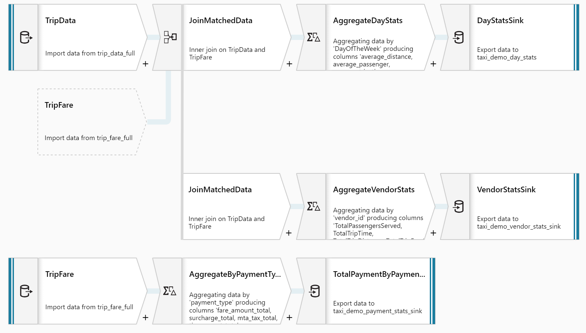
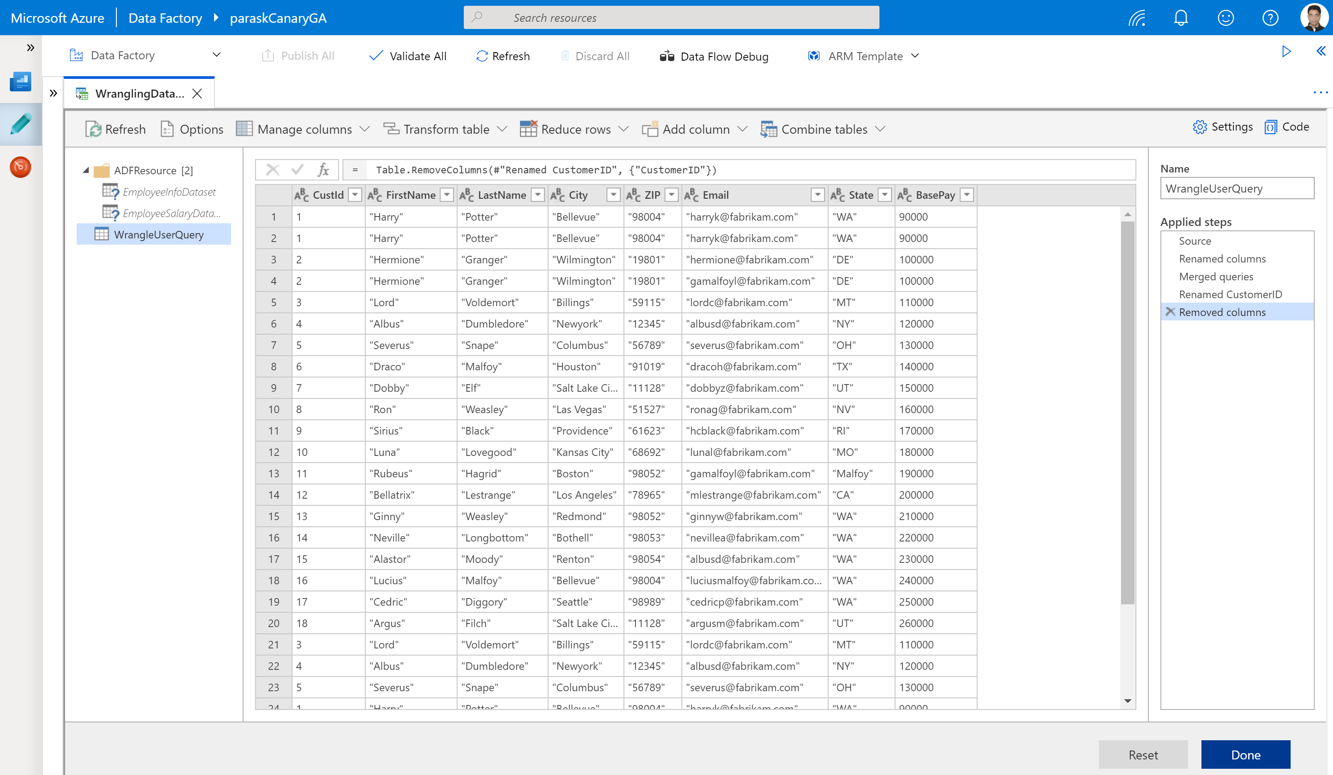
Azure Data Factory Data Flows
No-code data transformation and preparation @ scale
Mapping Dataflow
Code free data transformation @scale
Wrangling Dataflow
Code free data preparation @scale

Slide 33
Azure Synapse Analytics

Slide 34


Azure Synapse Analytics
Integrated data platform for BI, AI and continuous intelligence
Artificial Intelligence / Machine Learning / Internet of Things
Intelligent Apps / Business Intelligence
Designed for analytics workloads at any scale
Azure Synapse Analytics
SaaS developer experiences for code free and code first
Experience
Azure Synapse Analytics Studio
Platform
Multiple languages suited to different analytics workloads
MANAGEMENT
Languages
SQL
Python
.NET
Java
Scala
R
Integrated analytics runtimes available provisioned and serverless on-demand
SQL Analytics offering T-SQL for batch, streaming and interactive processing
Spark for big data processing with Python, Scala, R and .NET
SECURITY
Form Factors
PROVISIONED
ON-DEMAND
MONITORING
Analytics Runtimes
SQL
METASTORE
DATA INTEGRATION
Integrated platform services for, management, security, monitoring, and metastore
Azure
Data Lake Storage
Common Data Model
Enterprise Security
Optimized for Analytics
Data lake integrated and Common Data Model aware

Slide 35
Azure Synapse Analytics MPP Architecture
Cores
Memory
Cores
Memory
Cores
Memory
NVMe SSD
NVMe SSD
NVMe SSD
Compute
Cache
TempDB
Cache
TempDB
Cache
TempDB
Data
Remote storage
Snapshot backups
Log

Slide 36
Table Distributions
Round-robin distributed
Distributes table rows evenly across all distributions at random.
Hash distributed
Distributes table rows across the Compute nodes by using a deterministic hash function to assign each row to one distribution.
Replicated
Full copy of table accessible on each Compute node.
CREATE TABLE [dbo].[FactInternetSales]
(
[ProductKey] int NOT NULL,
[OrderDateKey] int NOT NULL,
[CustomerKey] int NOT NULL,
[PromotionKey] int NOT NULL,
[SalesOrderNumber] nvarchar(20) NOT NULL,
[OrderQuantity] smallint NOT NULL,
[UnitPrice] money NOT NULL,
[SalesAmount] money NOT NULL
)
WITH
(
CLUSTERED COLUMNSTORE INDEX,
DISTRIBUTION = HASH([ProductKey]) |
ROUND ROBIN |
REPLICATED
);

Slide 37
Polybase
Data ingestion using external data sources
-- Create Azure DataLake Gen2 Storage reference
CREATE EXTERNAL DATA SOURCE AzureStorage with
(
TYPE = HADOOP, LOCATION='abfss://<container>@<storageaccnt>.blob.core.windows.net',
CREDENTIAL = AzureStorageCredential –- not required if using managed identity
);
-- Type of format in Hadoop (CSV, RCFILE , ORC, PARQUET).
CREATE EXTERNAL FILE FORMAT TextFileFormat WITH
(
FORMAT_TYPE = DELIMITEDTEXT,
FORMAT_OPTIONS (FIELD_TERMINATOR ='|', USE_TYPE_DEFAULT = TRUE)
)
-- LOCATION: path to file or directory that contains data
CREATE EXTERNAL TABLE [dbo].[CarSensor_Data]
(
[SensorKey] int NOT NULL,
[Speed] float NOT NULL,
[YearMeasured] int NOT NULL
)
WITH (LOCATION='/Demo/’, DATA_SOURCE = AzureStorage, FILE_FORMAT = TextFileFormat
);
Overview
Polybase supports querying files stored in a Hadoop File System (HDFS), Azure Blob storage, or Azure Data Lake Store.
To query files, users create three objects: External data source, external file format, external table.

Slide 38
Lab 1: Load data into Azure Synapse Analytics using Azure Data Factory Pipelines

Slide 39
Lab 1
Load data into Azure Synapse Analytics using Azure Data Factory Pipelines

Slide 40
Lab 1
Lab Architecture

Slide 41
Modern Data Platform Concepts Part II

Slide 42
The Modern Data Problem
Velocity
Real-time
Volume
How to derive value from data:
What happened historically?
What is happening now?
What is going to happen?
ZB
Batch
GB
Structured data
Each dimension of data is constantly expanding
Unstructured data
Variety

Slide 43
What is a Data Lake?
It is a central storage repository that holds data coming from many sources in a raw, granular format. It can store structured, semi-structured, or unstructured data, which means data ingested quickly and can be kept in a more flexible format for future use cases.
Characteristics
Schema-on-read (ELT)
Collection of data, not a platform
Benefits
Quickly ingest high volumes of diverse data structures
Enable advanced analytics and data exploration
Scalability and storage cost reduction
Best Practices
Data Governance needed to avoid Data Swamp
Security considerations
Perfect place for evolving data
Design your Data Lake
Metadata management
Notes:
Characteristics

Slide 44
Data Warehouse or Data Lake?
Answer: both.
 | Data Warehouse | Data Lake
Requirements | Relational requirements | Diverse data, scalability, low cost
Data Value | Data of recognised high value | Candidate data of potential value
Data Processing | Mostly refined calculated data | Mostly detailed source data
Business Entities | Known entities, tracked over time | Raw material for discovering entities and facts
Data Standards | Data conforms to enterprise standards | Fidelity to original format and condition
Data Integration | Data integration upfront | Data prep on demand
Transformation | Data transformed, in principle | Data repurposed later, as needs arise
Schema Definition | Schema-on-write | Schema-on-read
Metadata Management | Metadata improvement | Metadata developed on read

Slide 45
Data Lake Design Considerations
Data Lake Zones
Transient Landing Zone
Temporary storage of data to meet regulatory and quality control requirements. Limited access. May not be required depending on requirements.
Raw Zone
Original source of data ready for consumption. Metadata publicly available but access to data still limited.
Trusted Zone
Standardized and enriched datasets ready for consumption to those with appropriate role-based access. Metadata available to all.
Curated/Refined Zone
Data transformed from Trusted Zone to meet specific business requirements.
Sandbox Zone
Playground for Data Scientists for ad hoc exploratory use cases.
Data Governance Considerations
Security and Compliance
Access Control at Folder/File level
Encryption at rest
Metadata Management
Data Quality
Metadata Management
Lifecycle Management

Slide 46
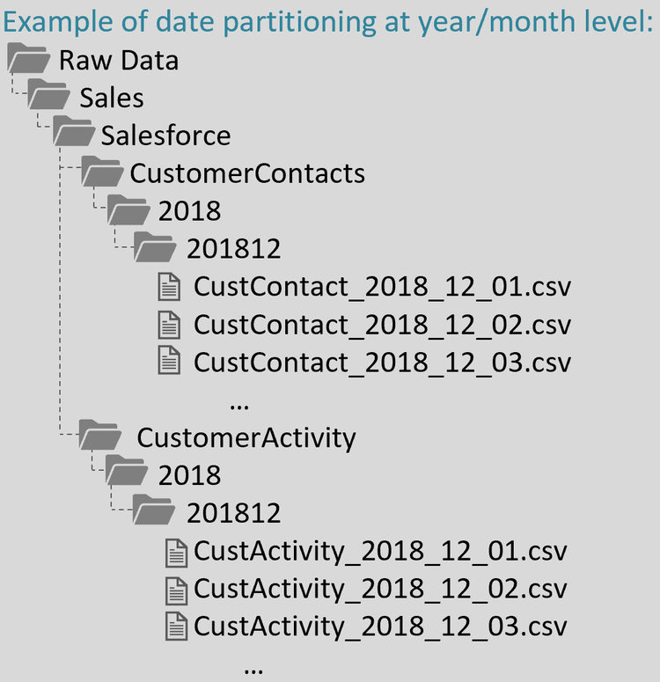
Data Lake Design Example
Data Lake Zone
Business Area
Source System
Entity Name
Year
Month
Data Files (standard naming convention)
Source: https://www.sqlchick.com/entries/2019/1/20/faqs-about-organizing-a-data-lake

Slide 47
Azure Data Lake Storage Gen2

Slide 48






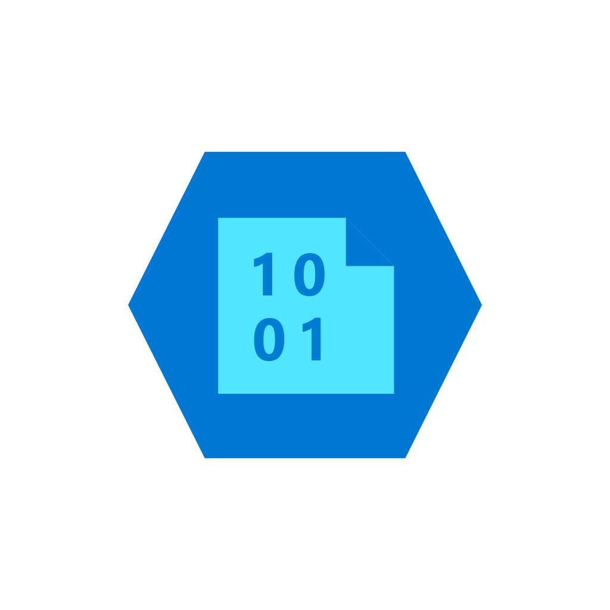
Azure Data Lake Storage Gen2
A “no-compromises” Data Lake: Secure, performant and massively-scalable
A Data Lake that brings together the cost and scale of object storage with the performance and analytics feature set of data lake storage
Fast
Manageable
Secure
Scalable
Cost effective
Integration ready
Atomic file operations mean jobs complete faster
Automated Lifecycle Policy Management
Object Level tiering
Support for fine-grained ACLs, protecting data at the file and folder level
Multi-layered protection via at-rest Storage Service encryption & Azure Active Directory integration
No limits on data store size
Global footprint (50 regions)
Object store pricing levels
File system operations minimize transactions required for job completion
Optimized for Spark and Hadoop Analytic Engines
Tightly integrated with Azure end to end analytics solutions
Multiprotocol access
+
Single service

Slide 49

Azure Data Lake Storage Gen2
High performance HDFS Endpoint to Azure Blob Storage
ADLS Gen2 API
Blob API
Hierarchical file system
File Data
Hadoop Filesystem, File and Folder Hierarchy, Granular ACLs
Unstructured Object Data
Server Backups, Archive Storage, Semi-structured Data
Security
Performance
Scale and cost effectiveness
Common Blob storage foundation
Common SDK, Tools, Control Plane
Object Tiering and Lifecycle Policy Management
AAD integration, RBAC, Storage account security
HA/DR support through ZRS and RA-GRS

Slide 50
Lab 2: Transform Big Data using Azure Data Factory Mapping Data Flows

Slide 51
Lab 2
Transform Big Data using Azure Data Factory Mapping Data Flows

Slide 52
Lab 2
Lab Architecture

Slide 53
Advanced Analytics

Slide 54
Advanced analytics
Advanced analytics goes beyond the traditional business intelligence (BI) and uses mathematical, probabilistic, and statistical modeling techniques to enable predictive processing and automated decision making.
SQL
Modern data warehousing
Advanced analytics
Real-time analytics
“We want to integrate all our data—including Big Data—with our data warehouse”
“We’re trying to predict when our customers churn”
“We’re trying to get insights from our devices in real-time”

Slide 55
Modern Data Platform Concepts Part III

Slide 56


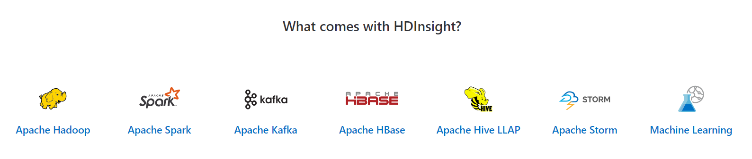
Hadoop and Spark in Azure
Open Source Apache Projects for Big Data Compute
It was the original open-source framework for distributed processing and analysis of big data sets on clusters.
Read/write from disk.
Economical batch mode.
Linear processing of huge datasets.
Effective, fast, general-purpose unified cluster computing framework with high-level APIs in Java, Scala, Python and R.
In-memory processing.
Fast, interactive data processing.
Streaming and Machine Learning Support
Azure HDInsight is a managed, full-spectrum, open-source analytics service for enterprises

Slide 57
Apache Spark Value Proposition
Performance
Run programs up to 100x faster than Hadoop MapReduce in memory
10x faster on disk
Useful for real-time and batch processing
Productivity
Write applications quickly in Scala or Python, Java
Over 80 high-level operators that make it easy to build parallel apps
Use interactively from the Scala and Python shells
Unified and integrated analytics model
Includes higher-level libraries in integrated framework
Combine SQL, streaming, graph processing
Runs on Hadoop (Yarn, Mesos), standalone, or in the cloud
Diverse data sources including HDFS (CSV, JSON, etc.), Azure Storage, Cosmos DB, Azure SQL Data Warehouse, Parquet, JDBC
Open
Apache Project
Contributors: 50 companies and over 400 developers, growing

Slide 58
Azure Databricks

Slide 59
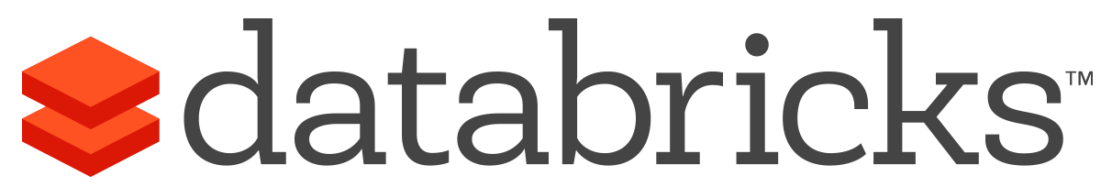


Azure Databricks
A fast, easy and collaborative Apache® Spark™ based analytics platform optimized for Azure
Best of Databricks
Best of Microsoft
Designed in collaboration with the founders of Apache Spark
One-click set up; streamlined workflows
Interactive workspace that enables collaboration between data scientists, data engineers, and business analysts.
Native integration with Azure services (Power BI, SQL DW, Cosmos DB, ADLS, Azure Storage, Azure Data Factory, Azure AD, Event Hub, IoT Hub, HDInsight Kafka, SQL DB)
Enterprise-grade Azure security (Active Directory integration, compliance, enterprise-grade SLAs)

Slide 60

Azure Databricks
Azure Databricks
Collaborative Workspace
IoT / streaming data
Machine learning models
DATA ENGINEER
DATA SCIENTIST
BUSINESS ANALYST
Deploy Production Jobs & Workflows
Cloud storage
BI tools
MULTI-STAGE PIPELINES
JOB SCHEDULER
NOTIFICATION & LOGS
Data warehouses
Optimized Databricks Runtime Engine
Data exports
Hadoop storage
DATABRICKS I/O
APACHE SPARK
SERVERLESS
Rest APIs
Data warehouses
Enhance Productivity
Build on secure & trusted cloud
Scale without limits

Slide 61



















Azure Databricks Deployment
Managed Resource Group
Cluster Node(s)
Attached Azure BLOB (DBFS)
Workspace
VNET
Workspace
NSG rules
Azure Portal
Integrate with other Azure Services
Azure BLOBs
Data Lake
Azure Databricks Workspace
Notebooks
Run on
Clusters
Event Hub
IOT Hub
Kafka
Cosmos DB
SQL DW
Jobs
Azure Resource Manager APIs
Interact using UI or Azure Databricks REST API
Data Factory

Slide 62
Azure Databricks Clusters
Driver Program SparkContext
Azure Databricks clusters are the set of Azure Linux VMs that host the Spark Worker and Driver Nodes
Your Spark application code (i.e. Jobs) runs on the provisioned clusters.
Azure Databricks clusters are launched in your subscription—but are managed through the Azure Databricks portal.
Azure Databricks provides a comprehensive set of graphical wizards to manage the complete lifecycle of clusters—from creation to termination.
Cluster Manager
Worker Node
Worker Node
Worker Node
Cache
Cache
Cache
Task
Task
Task
Data Sources (HDFS, SQL, NoSQL, …)

Slide 63
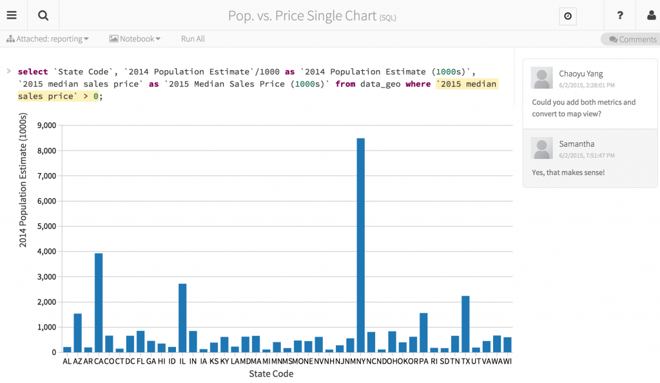
Azure Databricks Notebooks
Notebooks are a popular way to develop, and run, Spark Applications
Notebooks are not only for authoring Spark applications but can be run/executed directly on clusters
Shift+Enter
click the at the top right of the cell in a notebook
Submit via Job
Fine grained permissions support so they can be securely shared with colleagues for collaboration
Notebooks are well-suited for prototyping, rapid development, exploration, discovery and iterative development
With Azure Databricks notebooks you have a default language but you can mix multiple languages in the same notebook:
%python Allows you to execute python code in a notebook (even if that notebook is not python)
%sql Allows you to execute sql code in a notebook (even if that notebook is not sql).
%r Allows you to execute r code in a notebook (even if that notebook is not r).
%scala Allows you to execute scala code in a notebook (even if that notebook is not scala).
%sh Allows you to execute shell code in your notebook.
%fs Allows you to use Databricks Utilities - dbutils filesystem commands.
%md To include rendered markdown

Slide 64
Lab 3: Explore Big Data with Azure Databricks

Slide 65
Lab 3
Explore Big Data with Azure Databricks

Slide 66
Lab 3
Lab Architecture

Slide 67
Modern Data Platform Concepts Part IV

Slide 68
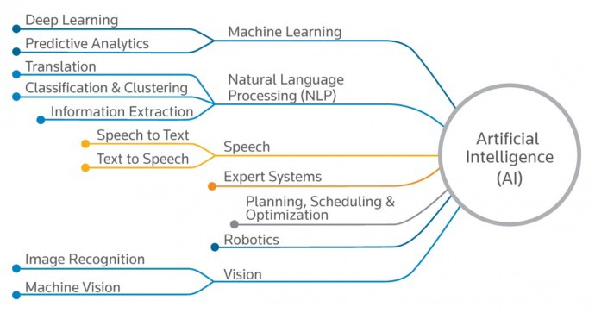
Artificial Intelligence
“The ability of a digital computer or computer-controlled robot to perform tasks commonly associated with intelligent beings.” – Encyclopedia Britannica
Machine Learning
Supervised Learning
Regression
Classification
Unsupervised Learning
Cluster Analysis
Application Examples
Weather Forecast
Fraud Detection
Customer Churn
Insurance Premium

Slide 69
What’s No-SQL?
Term coined in 2009 for a developer meetup – ”Not Only SQL” -> “NoSQL”.
Databases that allow you to store and retrieve data in various structures, formats, and models other than tabular relational model.
There’s a time and a place for everything
Sometimes a relational store is the right choice
Sometimes a NoSQL store is the right choice
Sometimes you need more than one store for an app -> polyglot persistence
Data Structures
Key-Value Databases
Cosmos DB, Redis Cache, Azure Table
Column Family Stores
Cosmos DB, Cassandra, HBase
Graph Databases
Cosmos DB, Neo4j, Gremlin
Document Databases
Cosmos DB, MongoDB

Slide 70
Azure AI

Slide 71
Azure AI
Solution Areas
AI apps and agents
Knowledge mining
Machine learning
Azure Cognitive Services
Azure Bot Service
Azure Search
Azure Databricks
Azure Machine Learning
Azure AI Infrastructure
Productive
Built for enterprises
Trusted
Notes:
There are three main areas in our portfolio, let’s talk about each of them

Slide 72






Machine Learning on Azure
Domain specific pretrained models
To simplify solution development
…
Vision
Speech
Language
Search
Familiar Data Science tools
To simplify model development
Visual Studio Code
Azure Notebooks
Jupyter
Command line
Popular frameworks
To build advanced deep learning solutions
PyTorch
TensorFlow
Scikit-Learn
ONNX
Productive services
To empower data science and development teams
Azure Databricks
Azure Machine Learning
Machine Learning VMs
Powerful infrastructure
To accelerate deep learning
CPU
GPU
FPGA
From the Intelligent Cloud to the Intelligent Edge
Notes:
The way we think about ML on Azure is very simple – we break it into what customers want for their ML solutions. There are 5 key asks
Talk about pre-trained models here, as no special slide for that
- For the rest of the stack, it comprises of everything needed for Data Scientists.

Slide 73
Custom Speech
Speech API
Bing Spell Check
Text Analytics
Translator Speech
Speech
Unified Speech
Text to speech
Bing Speech
Translator Text
Language
Speaker Recognition
Cognitive Services Lab
Language Understanding (LUIS)
Cognitive Services APIs
Computer Vision
Knowledge
Custom Vision
QnA Maker
Custom Decision
Bing Visual Search
Video Indexer
Bing Entity Search
Vision
Bing Statistics add-in
Bing Custom Search
Emotion
Bing Search
Bing Autosuggest
Search
Content Moderator
Face
Notes:
Overview of Cognitive Services

Slide 74





Cognitive Services capabilities Infuse your apps, websites, and bots with human-like intelligence
Vision
Speech
Language
Knowledge
Search
Object, scene, and activity detection
Face recognition and identification
Celebrity and landmark recognition
Emotion recognition
Text and handwriting recognition (OCR)
Customizable image recognition
Video metadata, audio, and keyframe extraction and analysis
Explicit or offensive content moderation
Speech transcription (speech-to-text)
Custom speech models for unique vocabularies or complex environment
Text-to-speech
Custom Voice
Real-time speech translation
Customizable speech transcription and translation
Speaker identification and verification
Language detection
Named entity recognition
Key phrase extraction
Text sentiment analysis
Multilingual and contextual spell checking
Explicit or offensive text content moderation
PII detection for text moderation
Text translation
Customizable text translation
Contextual language understanding
Q&A extraction from unstructured text
Knowledge base creation from collections of Q&As
Semantic matching for knowledge bases
Customizable content personalization learning
Ad-free web, news, image, and video search results
Trends for video, news
Image identification, classification and knowledge extraction
Identification of similar images and products
Named entity recognition and classification
Knowledge acquisition for named entities
Search query autosuggest
Ad-free custom search engine creation
Notes:
Vision: Image-processing algorithms to smartly identify, caption and moderate your pictures
Computer vision: Distill actionable information from images
Content Moderator: Automatically moderate potentially offensive images, text and videos
Customer Vision Service: Train a web service to recognize specific content in images
Face: Identify human faces and emotions in images
Video indexer: Easily extract insights from your videos to enrich your applications
Speech: Convert spoken audio into text, use voice for verification, or add speaker recognition to your app
Bing Speech: Convert speech to text and text to speech
Speaker Recognition: Use speech to identify and authenticate individual speakers
Custom Speech Service: Overcome speech recognition barriers like speaking style, background noise, and vocabulary
Translator Speech: Easily conduct real-time speech translation on your app
Language: Enable your apps to process natural language with pre-built scripts, evaluate sentiment and learn how to recognize what users want
Bing Spell Check: Add spell checking functionality to your app
Language Understanding (LUIS): Add language understanding intelligence to your apps with minimal effort
Linguistic Analysis: Easily parse complex text with language analysis
Text Analytics: Easily evaluate sentiment, language, and key phrases to understand what users want
Translator Text: Easily conduct machine translation for 60+ languages
Knowledge: Map complex information and data in order to solve tasks such as intelligent recommendations and semantic search
Knowledge Exploration Service: Enable interactive search experiences over structured data via natural language inputs
Entity Linking Service: Power your app's data links with named entity recognition and disambiguation
Academic Knowledge: Tap into the wealth of academic content in the Microsoft Academic Graph using the Academic Knowledge API
QnA Maker: Distill information into an easy-to-navigate FAQ for bot services
Customer Decision Service: Create custom experiences with adaptive, contextual decision-making
Search: Add Bing Search APIs to your apps and harness the ability to comb billions of webpages, images, videos, and news with a single API call
Bing Autosuggest: Give your app intelligent autosuggest options for searches
Bing News Search: Search for news and get comprehensive results
Bing Web Search: Get enhanced search details from billions of web documents
Bing Entity Search: Enrich your experiences by identifying and augmenting entity information from the web
Bing Image Search: Search for images and get comprehensive results
Bing Video Search: Search for videos and get comprehensive results
Bing Custom Search: Create tailored site search or vertical search experiences for topics you care about
Labs: Cognitive Services Labs are early preview limited availability leading innovation APIs and SDKs that allow developers to start experimenting with Microsoft’s latest and greatest Cognitive Services.
Project Prague: SDK to incorporate gesture-based controls into your apps. Quickly define and implement customized hand gestures, creating a more natural user experience. Limited private preview availability at launch.
Project Cuzco: API to help developers find events associated with Wikipedia entities. Begin with a Wikipedia entity, and receive a list of related events organized by time.
Project Johannesburg: API to calculate route logistics for with deeper location intelligence to account for specific enterprise requirements. IE: weight, height length, hazardous materials, etc.
Project Nanjing: API to calculate isochrones - time and distance-based recommendations for enterprise route optimization.
Project Abu Dhabi: API to create distance matrices, enabling you to calculate a histogram of travel times, and serve as stepping stone for enterprise route optimization.
Project Wollongong: API to help ‘score’ the attractiveness of a location, based on how many of a particular amenity are within a specific distance. Ex: restaurants, parks, transit stops.
With Cognitive Services, developers can easily add intelligent features – such as emotion and sentiment detection, vision and speech recognition, knowledge, search and language understanding – into their applications. The collection will continuously improve, adding new APIs and updating existing ones.
Cognitive Services includes:
<click>
Vision: From faces to feelings, allow apps to understand images and video
<click>
Speech: Hear and speak to users by filtering noise, identifying speakers, and understanding intent
<click>
Language: Process text and learn how to recognize what users want
<click>
Knowledge: Tap into rich knowledge amassed from the web, academia, or your own data
<click>
Search: Access billions of web pages, images, videos, and news with the power of Bing APIs
Why choose these APIs? They work, and it’s easy.
<click>
Easy: The APIs are easy to implement because of the simple REST calls. There’s a common way to implement, and you can get started with all of them for free simply by going to one place, one website, www.microsoft.com/cognitive.
Flexible: We’ve got a breadth of intelligence and knowledge APIs so developers will be able to find what intelligence feature they need. And, importantly, they all work on whatever language, framework, or platform developers choose. So, developers can integrate into their apps—iOS, Android, Windows—using their own tools they know and love.
Tested: Tap into an ever-growing collection of powerful AI algorithms developed by experts. Developers can trust the quality and expertise build into each API by experts in their field from Microsoft’s Research organization, Bing, and Azure machine learning and these capabilities are used across many Microsoft first party products such as Cortana, Bing and Skype.
Transition: When it comes to real-world applications for Cognitive Services, the sky is the limit! Let’s look at some examples.
<click>

Slide 75



Knowledge mining with Azure Search
Documents
Cognitive skills
Fully text-searchable rich index
Key Phrase extraction
Location entity extraction
Sentiment analysis
Organization entity extraction
Persons entity extraction
Language detection
Face detection
Celebrity recognition
Tag extraction
Custom skills
Landmark detection
Printed text recognition
Notes:
The new cognitive capabilities in Azure Search enable you to extract and index key information from documents
With Cognitive Search, users can explore and convert a variety of file types into searchable text
Common applications include making it easier for people inside the organization to connect (i.e. find people with experience in carbon fiber design).
The MET Museum and Real Madrid are levering this also as a way to more deeply engage with customers. In Real’s case, they saw a 30% increase in digital revenues

Slide 76
Cosmos DB

Slide 77





Azure Cosmos DB
Core (SQL) API
Table API
MongoDB
Column-family
Document
Key-value
Graph
Guaranteed low latency at the 99th percentile
Elastic scale out
of storage & throughput
Five well-defined consistency models
Turnkey global distribution
Comprehensive SLAs

Slide 78
Resource Model
Account
Database
Database
Database
Database
=
Database
Container
Collection
Graph
Table
Database
Database
Item

Slide 79
Container-Level Resources
Account
Database
Database
Database
Database
Database
Container
Database
Database
Sproc
Trigger
UDF
Conflict
Item

Slide 80
Lab 4: Add AI to your Big Data Pipeline with Cognitive Services

Slide 81
Lab 4
Add AI to your Big Data Pipeline with Cognitive Services

Slide 82
Lab 4
Lab Architecture

Slide 83
Real-time Analytics

Slide 84
Real-time analytics
Deals with streams of data that are captured in real-time and processed with minimal latency to generate real-time (or near-real-time) reports or automated responses.
SQL
Modern data warehousing
Advanced analytics
Real-time analytics
“We want to integrate all our data—including Big Data—with our data warehouse”
“We’re trying to predict when our customers churn”
“We’re trying to get insights from our devices in real-time”

Slide 85
Modern Data Platform Concepts Part V

Slide 86







Streaming Use Cases
Retail
Financial
Oil/Gas & Energy
Security
CONSUMER ENGAGEMENT
RISK AND REVENUE MANAGEMENT
GRID OPS, ASSET OPTIMIZATION
ACTIONABLE THREAT INTELLIGENCE
Real-time Pricing Optimization
Risk and Fraud, Threat Detection
Industrial IoT
Security Intelligence
Demand-Elasticity
Personal Pricing Schemes
Promotion events
Multi-channel engagement
Real-time anomaly detection
Card Monitoring and Fraud Detection
Risk Aggregation
Preventive Maintenance
Smart Grids and Microgrids
Asset performance as a Service
UAV image analysis
Real-time firewall, network, and auth log correlation
Anomaly detection
Security context, enrichment
Security Orchestration
Healthcare
Advertising
Media Entertainment
SENSOR DATA
RECOMMENDATION ENGINE
CONSUMER ENGAGEMENT ANALYSIS
And Much More!
IoT DEVICE
ANALYTICS
Next Best and Personalized Offers
Sentiment Analysis
Aggregation of streaming events
Predictive Maintenance
Anomaly Detection
Right product, promotion, at right time
Real time Ad bidding platform
Personalized Ad Targeting
Demand-Elasticity
Social Network Analysis
Promotion events
Multi-channel Attribution

Slide 87

Unlocking Real-time Insights
Time to Insight is Critical
Reducing decision latency can unlock business value
Insights are Perishable
Window of opportunity for insights to be actionable
Ask Questions to Data in Motion
Can’t wait for data to get to rest before running computation

Slide 88

Real-time Stream Processing
Simple Event Processing
Filter
Transform
Enrich
Split
Route
Event Stream Processing
[Simple event processing] +
Aggregate
Rules
Complex Event Processing
[Event Stream Processing] +
Pattern detection
Time windows
Joins & correlations

Slide 89
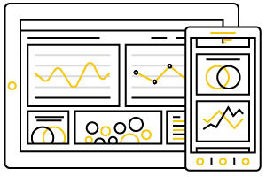
Scenario Types
Actions by Human Actors
“See and seize” insights
Live visualization
Alerts and alarms
Dynamic aggregation
Machine to Machine Interactions
Data movement with enrichment
Kick-off workflows for automation
Dashboarding
Automation
Enriched Data Movement

Slide 90
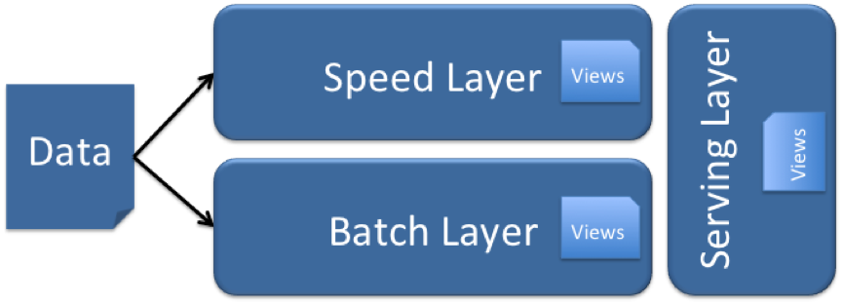
Lambda (λ) Architecture
Designed to handle Big Data use cases by taking advantage of both batch and stream-processing methods
All data entering the system is dispatched to both the batch layer and the speed layer for processing.
The batch layer has two functions:
manage the master dataset (an immutable, append-only set of raw data)
pre-compute the batch views.
The serving layer indexes the batch views so that they can be queried in low-latency, ad-hoc way.
The speed layer compensates for the high latency of updates to the serving layer and deals with recent data only.
Any incoming query can be answered by merging results from batch views and real-time

Slide 91
Event Hubs

Slide 92

Event Hubs
Big data streaming platform and event ingestion service capable of receiving and processing millions of events per second.

Slide 93
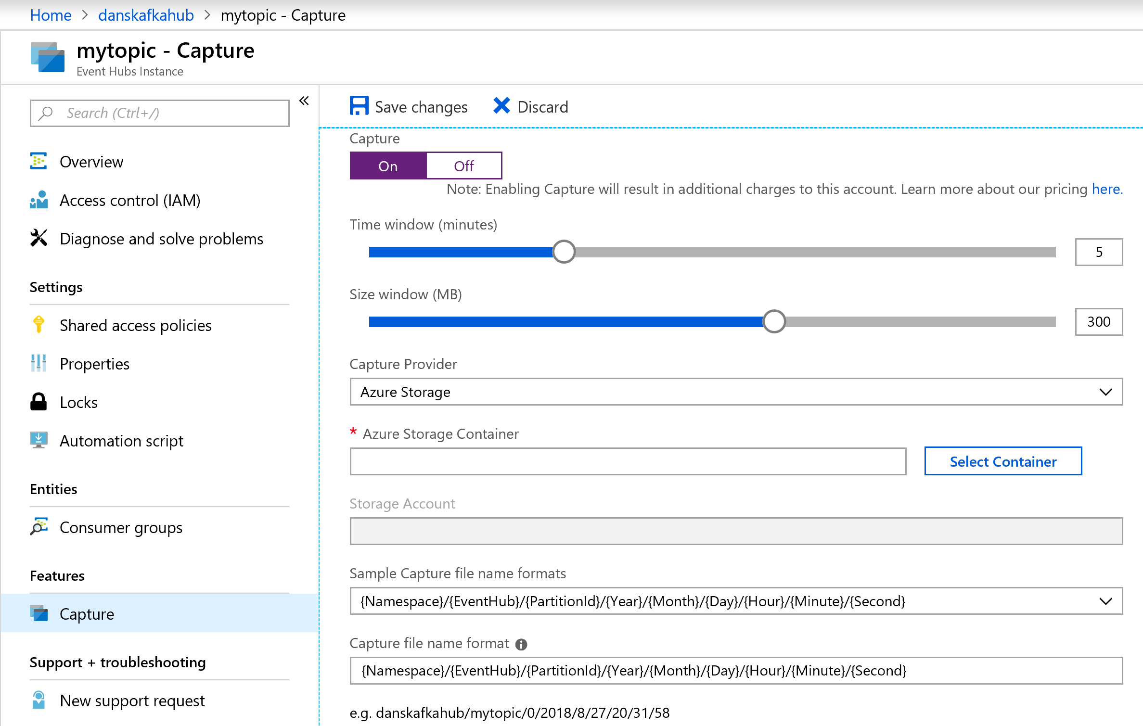
Event Hubs Capture
Batch on stream
Policy based push to your own storage
Uses Avro format
Raises Event Grid events – connect to Functions, ACI, or whatever you like
Does not impact throughput
Offloads batch processing from your real-time stream

Slide 94
Stream Analytics

Slide 95
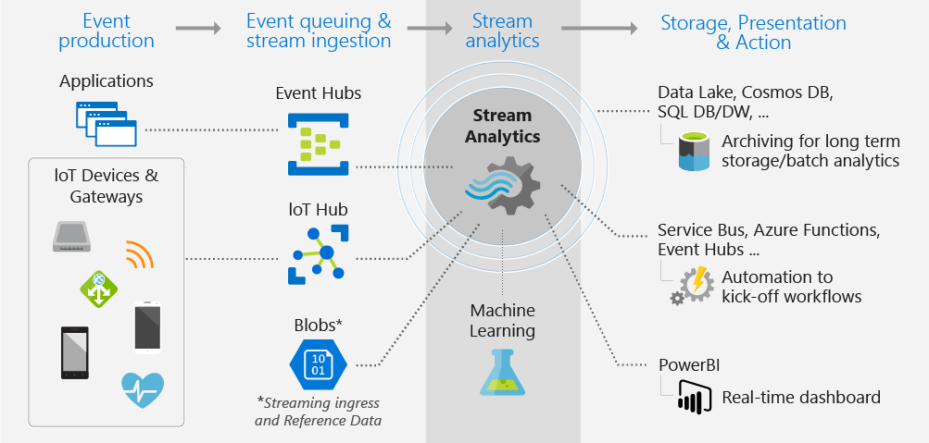
Stream Analytics
Event-processing engine that allows you to examine high volumes of data streaming from devices

Slide 96
Differentiators
1,915 lines of code with Apache Storm
Programmer Productivity
Declarative SQL like language
Built-in temporal semantics
Ease of Getting Started
Integrations with sources, sinks, & ML
Build real-time dashboards in minutes
Lowest Total Cost of Ownership(TCO)
Fully managed service
No cluster topology management required
Seamless scalability
Usage based pricing
@ApplicationAnnotation(name="WordCountDemo")
public class Application implements StreamingApplication
{
protected String fileName = "com/datatorrent/demos/wordcount/samplefile.txt";
private Locality locality = null;
@Override public void populateDAG(DAG dag, Configuration conf)
{
locality = Locality.CONTAINER_LOCAL;
WordCountInputOperator input = dag.addOperator("wordinput", new WordCountInputOperator());
input.setFileName(fileName);
UniqueCounter<String> wordCount = dag.addOperator("count", new UniqueCounter<String>());
dag.addStream("wordinput-count", input.outputPort, wordCount.data).setLocality(locality);
ConsoleOutputOperator consoleOperator = dag.addOperator("console", new ConsoleOutputOperator());
dag.addStream("count-console",wordCount.count, consoleOperator.input);
}
}
3 lines of SQL in Azure Stream Analytics
SELECT Avg(Purchase), ScoreTollId, Count(*)
FROM GameDataStream
GROUP BY TumblingWindows(5, Minute), Score

Slide 97
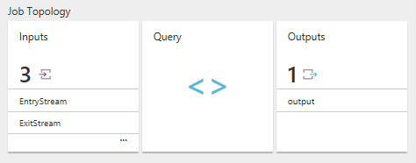
Stream Analytics Job
Users construct and deploy jobs to Azure Stream Analytics
Job definition includes inputs, a query, and output
Inputs are from where the job reads the data stream
Query runs for perpetuity unless explicitly stopped and transforms the input stream
Output is where the job sends the job results to

Slide 98
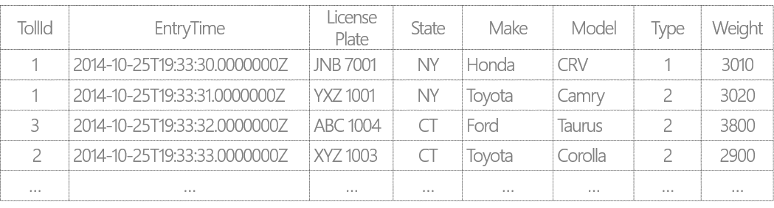
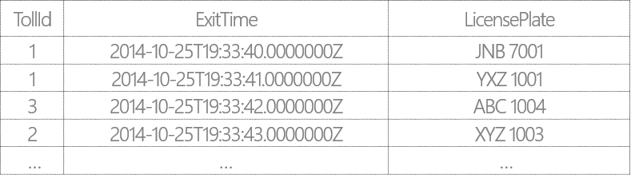
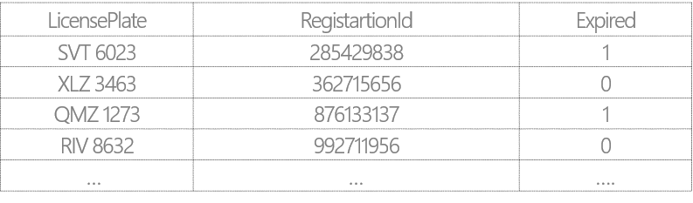
Example Scenario: Tolling Stations
Tolling stations have multiple booths (identified by TollId)
Each booth has two sensors: Entry and Exit that send out EntryStream and ExitStream respectively
EntryStream – Data stream from the Entry sensor data on vehicles entering toll booths
ExitStream - Data stream from the Exit sensor on vehicles exiting toll booths
ReferenceData - Commercial vehicle registration data

Slide 99
Filters and Projections
SELECT VehicleCategory =
Case Type
WHEN 1 THEN ‘Passenger’
WHEN 2 THEN ‘Commercial’
ELSE THEN ‘Other’
END,
TollId,
LicensePlate,
State,
Make,
Model,
DATEPART(mi,EntryTime) AS ‘Mins’,
DATEPART(ss,EntryTime) AS ‘Seconds’
DATEPART(ms,EntryTime) AS ‘Milleseconds’
FROM EntryStream TIMESTAMP BY EntryTime
WHERE (State = ‘CA’ OR State = ‘WA’)
AND Weight < 3000
AND CHARINDEX (‘M’, model) = 0
AND PATINDEX(‘%999’, LicensePlate) = 5
From the incoming stream find only vehicles that:
Are from either WA and CA state
Have a weight less than 3000 lbs
Have License plate number end in 999
Have a make that starts with a “M”
Display:
“Passenger” if type = 1
“Commercial” if Type = 2
“Other” for all other types
Display time as ‘Mins’, ‘Seconds’, ‘Milliseconds’

Slide 100
Temporal Joins
Report the time in seconds required for vehicles to pass the toll booth
SELECT ES.TollId,
ES.EntryTime,
EX.ExitTime,
ES.EntryTime,
ES.LicensePlate DATEDIFF(minute, ES.EntryTime, EX.ExitTime )
FROM EntryStream ES TIMESTAMP BY EntryTime
JOIN ExitStream EX TIMESTAMP BY ExitTime
ON (EX.TollId= ES.TollId and ES.LicensePlate = EX.LicensePlate)
AND DATEDIFF(minute, ES, EX) BETWEEN 0 AND 15

Slide 101
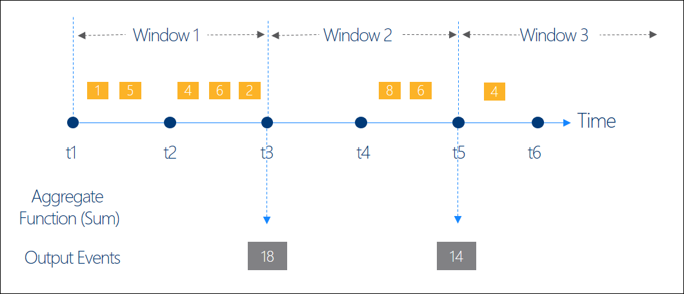
Windowing Concepts
Operations on the data contained in temporal windows is a common pattern
Four types of Temporal Windows:
Sliding
Tumbling
Hopping
Session
Output at the end of each window
Windows are fixed length
Used in a GROUP BY clause

Slide 102
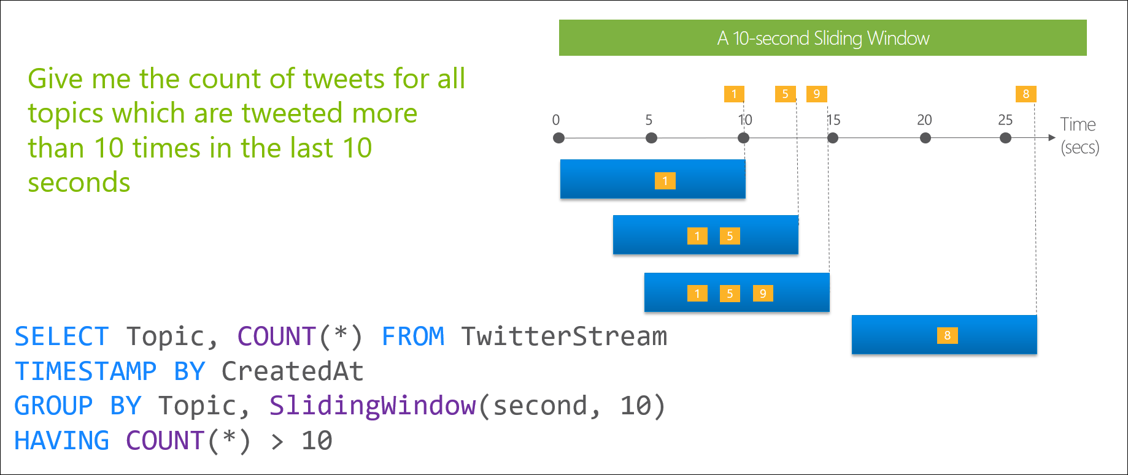
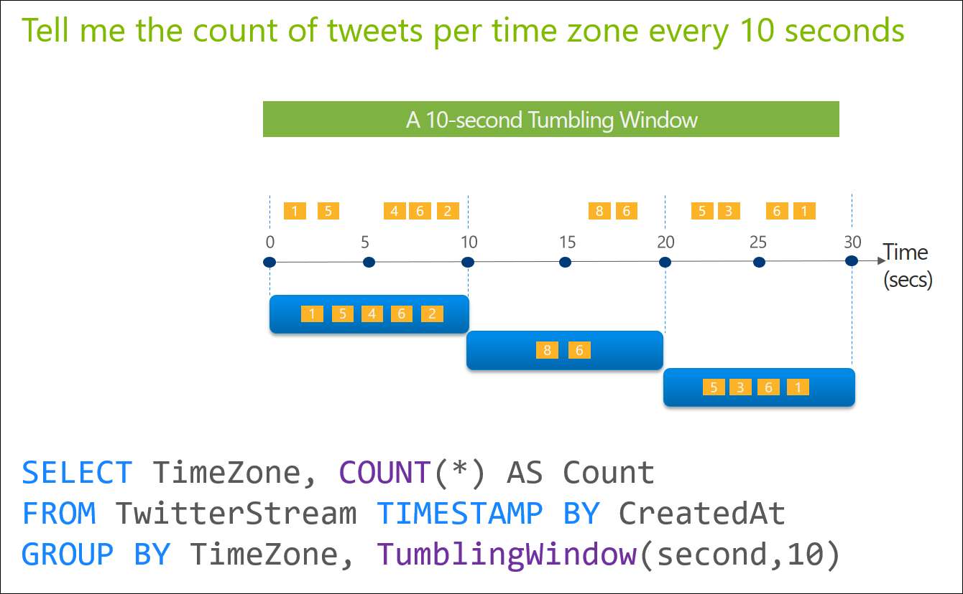
Windowing Functions
Sliding Windows and Tumbling Windows
Sliding Windows
Tumbling Windows

Slide 103
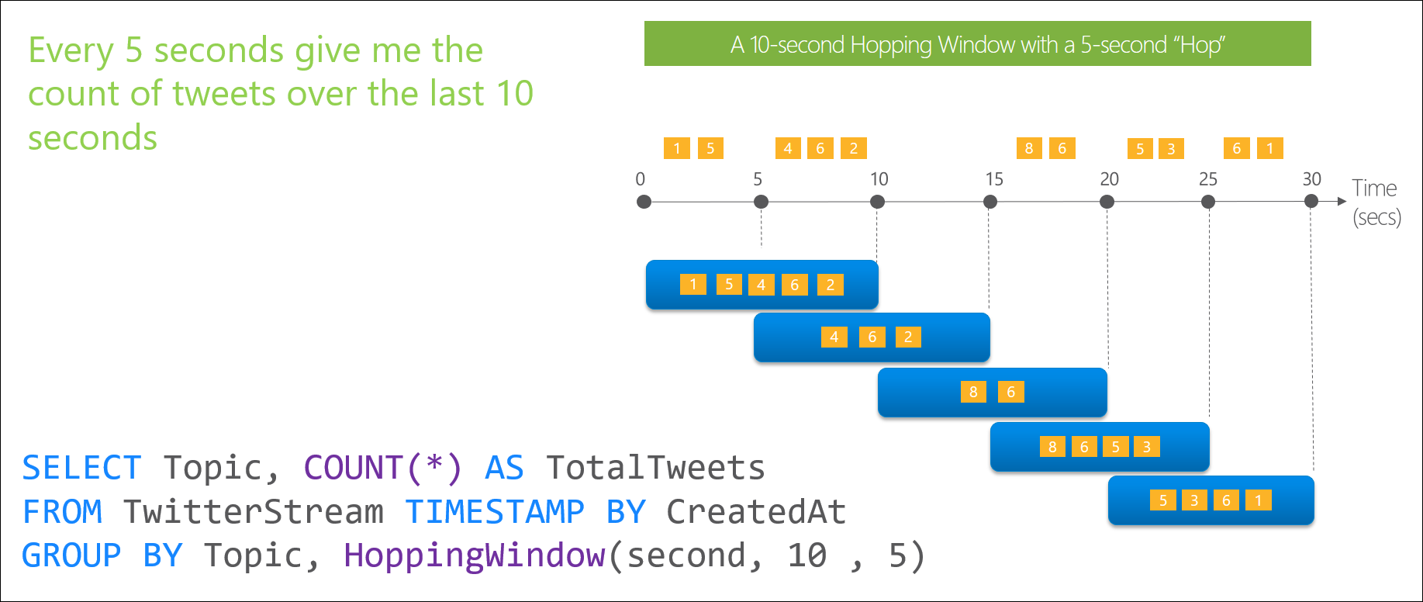
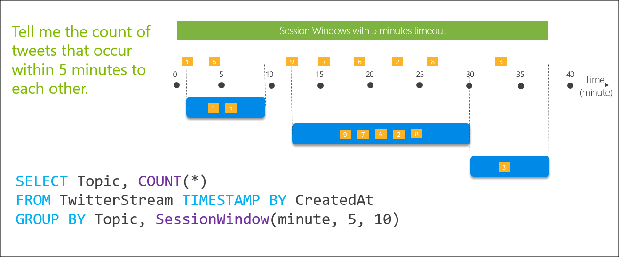
Windowing Functions
Hopping Windows and Session Windows
Hopping Windows
Session Windows

Slide 104
Lab 5: Ingest and Analyse real-time data with Event Hubs and Stream Analytics

Slide 105
Lab 5
Ingest and Analyse real-time data with Event Hubs and Stream Analytics

Slide 106
Lab 5
Lab Architecture

Slide 107
It’s all on
Notes:
With Azure, you can be more productive. Azure has more than 100 services with great end-to-end tools to make you successful.
Develop and deploy where you want, with the only consistent hybrid cloud on the market. Extend Azure on-premises with Azure Stack.
Create intelligent apps using powerful data and AI services.
Develop with confidence on the trusted cloud.
<Transition>: Join startups, governments, and 90% of Fortune 500 businesses who run on the Microsoft Cloud today.

